Slide 1
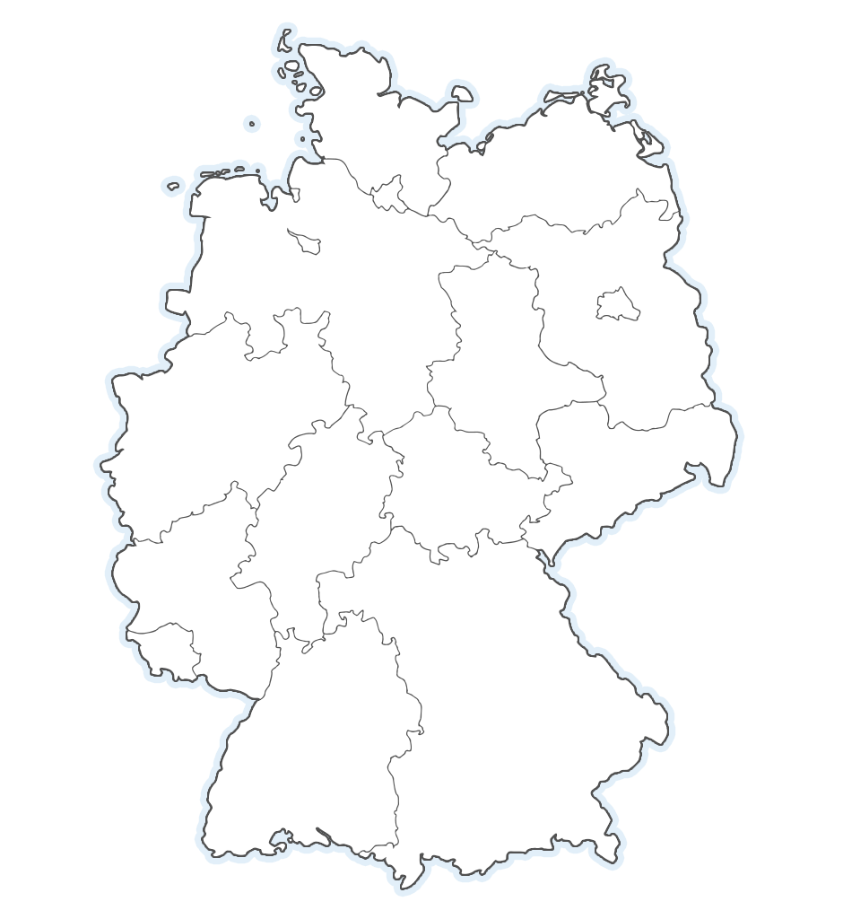
XRG Simulation GmbH
Founded in 2005
Specialist for energy system simulation and related simulation products
Selected References
Car manufacturers: Volkswagen, Audi, Daimler, BMW
Aviation industry: Airbus Operations GmbH
Power plant industry: Eon, Vattenfall
HVAC: Mitsubishi Electric
COMPANY SITES
Hamburg (HQ)
Bremen
Böblingen (Stuttgart)
Ingolstadt
München (LTX)

Slide 2
Company Profile
COMPANY PROFILE
SERVICES
PRODUCTS
XRG stands for exergy. The company was founded in 2005 and is focussed on the modelling and simulation of thermal energy systems.
From the start we have been working for the most advanced companies and research institutions in their field, because we share our customer‘s passion for his products. We don‘t stop at delivering excellent results but want to go further to let the simulation become part of the real world.
XRG is best in
Simulation services
Simulation products
Research and Development

Slide 3
Services
COMPANY PROFILE
SERVICES
PRODUCTS
Our highly qualified engineers, physicists and IT-specialists are open-minded and offer high-tech services in
Modelling and programming
Simulation and post-processing
Subcontracted research projects
Application development
Training
for our customers from the automotive, aviation, building, process and power plant industry.

Slide 4
Automotive
> Modelling and simulation of air conditioning, cooling and air ventilation systems
> Investigation of energy efficiency and thermal comfort for conventional or future refrigeration and heat pump systems including cabins
> Dymola/Modelica, AirConditioningTM, TIL, Flowmaster, Kuli, HumanComfortTM
AUTOMOTIVE CABIN

Slide 5
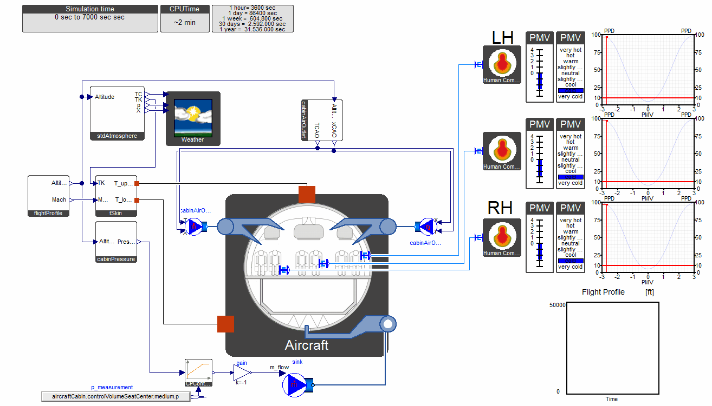
Aviation
> Future environmental control systems and cabin architectures
> Specialised on new modelling and simulation techniques. Development of tools and applications for easy analysis and optimisation of complex systems
> Subcontracted in many research projects
AIRCRAFT CABIN

Slide 6
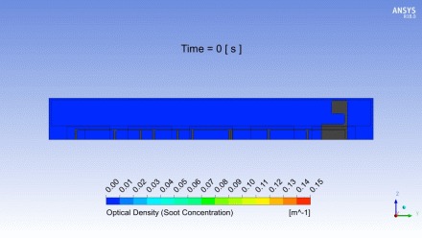
Building
> High expertise in modelling and simulation of large HVAC systems for offices and industrial facilities
> Transient smoke removal and occupant escape simulation
> Development of future HVAC systems by using most advanced simulation tools
SMOKE REMOVAL SIMULATION

Slide 7
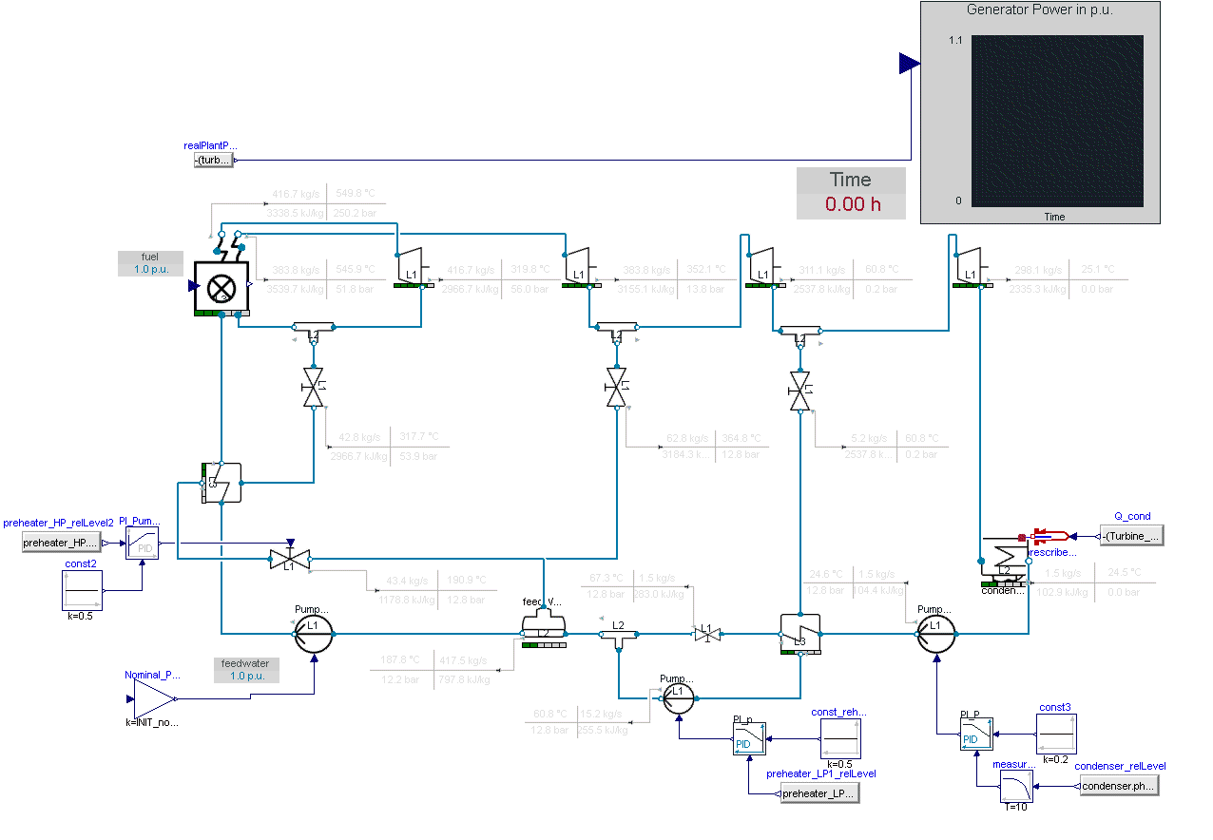
Power Plant
> Modelling and simulation of transient power plant processes with a special focus on control optimisation
> Coal-fired power plants, Combined cycles and Solar power plants
> Testing of failure scenarios and innovative and efficient control strategies
LOAD CHANGE

Slide 8
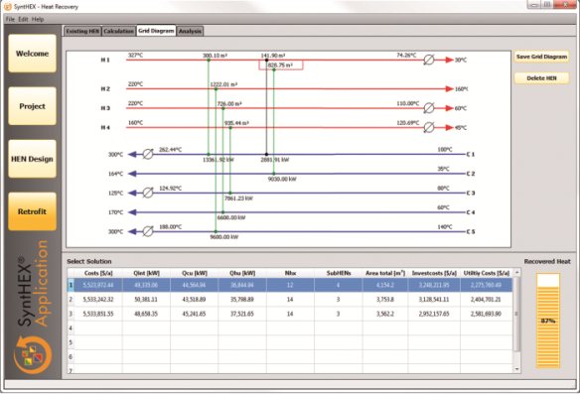
Process
> Intelligent optimisation of heat exchanger networks using SyntHEXTM
> Genetic algorithms automatically generate efficient and robust layouts
> For new or existing plants
> Save up to 25% of investment and operating costs compared with conventional Heat Exchanger Network Design Optimization*
HEAT RECLAIM
* Using Pinch-Method

Slide 9
Products
COMPANY PROFILE
SERVICES
PRODUCTS
> XRGLibraries
Thermal comfort in air-conditioned zones
ClaRa
Transient power stations
Library
Heating, ventilation and air-conditioning
Pressure loss and heat transfer correlations
Liquid heating and cooling cycles
Computational fluid dynamics
> XRGApplications
Optimisation of heat exchanger networks
Excel Interface for FMU and Dymola
Model optimization and calibration

Slide 10
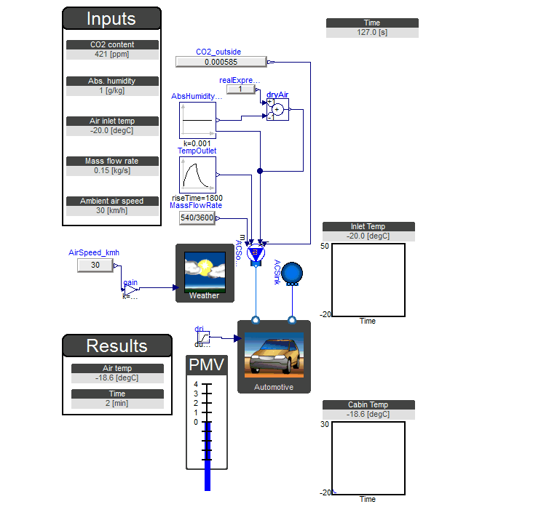
Air-conditioned Zones
> The XRGLibrary HumanComfortTM models the dynamic, thermal behaviour of buildings, vehicles, ship and aircraft cabins and displays thermal comfort.
> The library provides a modular description of all heat and mass transfer processes (incl. condensation and CO2 balances). Compatible with Modelica.Fluid.
CABIN HEAT-UP

Slide 11
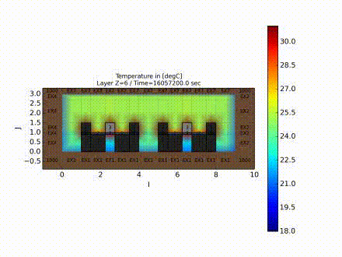
Computational Fluid Dynamics
> The FluidDynamics library carries out CFD-Simulations using Modelica language and provides standard interfaces to 1D-Modelica-models for a seamless connection. The fluid dynamics are purely modelled by using Modelica language.
> Grid generation and post-processing (see left) using XRG Score.
OFFICE ROOM

Slide 12
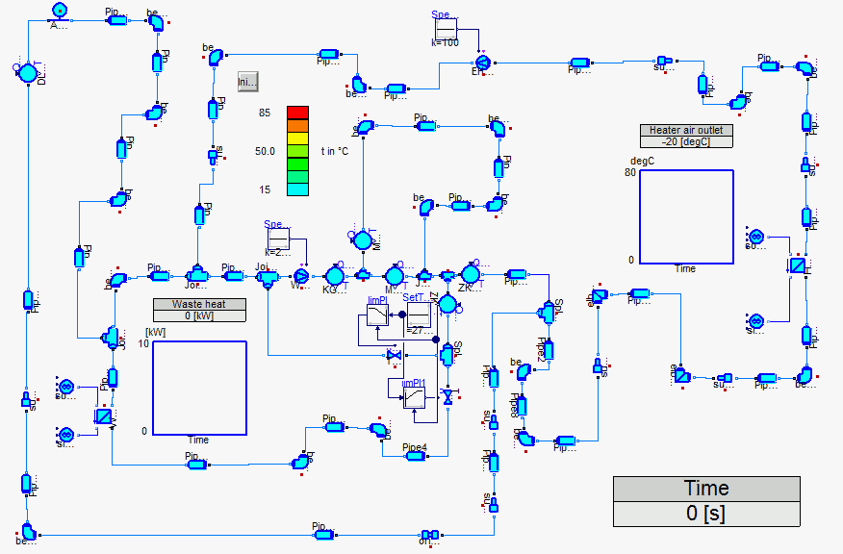
Liquid Hydraulic Networks
> The XRGLibrary HydronicsTM enables the modelling of liquid fluid circuits.
> Detailed pressure loss and heat transfer functions for most common components.
> Compatible with Modelica.Fluid and AirConditioning LibraryTM. In the last case an Add-on library provides adaptions of AirConditioning liquid media models.
COOLING CIRCUIT

Slide 13
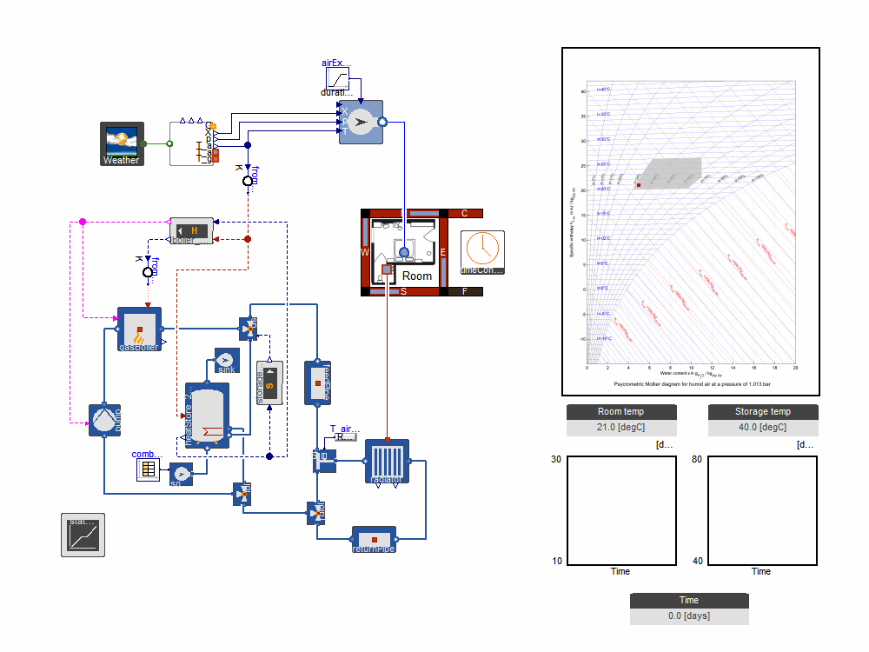
HVAC Systems
> The HVACLib allows the fastest transient whole-year simulations within a few minutes.
> Systematic parameter optimization through mathematical algorithms (e.g., using XRG’s ModelOpt tool).
> License includes HumanComfort LibraryTM for combined building simulation (see animation).
HEATING SYSTEM

Slide 14
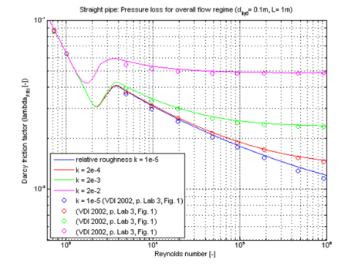
Pressure Drop and Heat Transfer
STRAIGHT PIPE
> The aim of the FluidDissipation Library is to provide models for a broad range of convective heat transfer and pressure loss correlations.
> Required in many thermo-hydraulic applications.
> Free software for download from here.

Slide 15
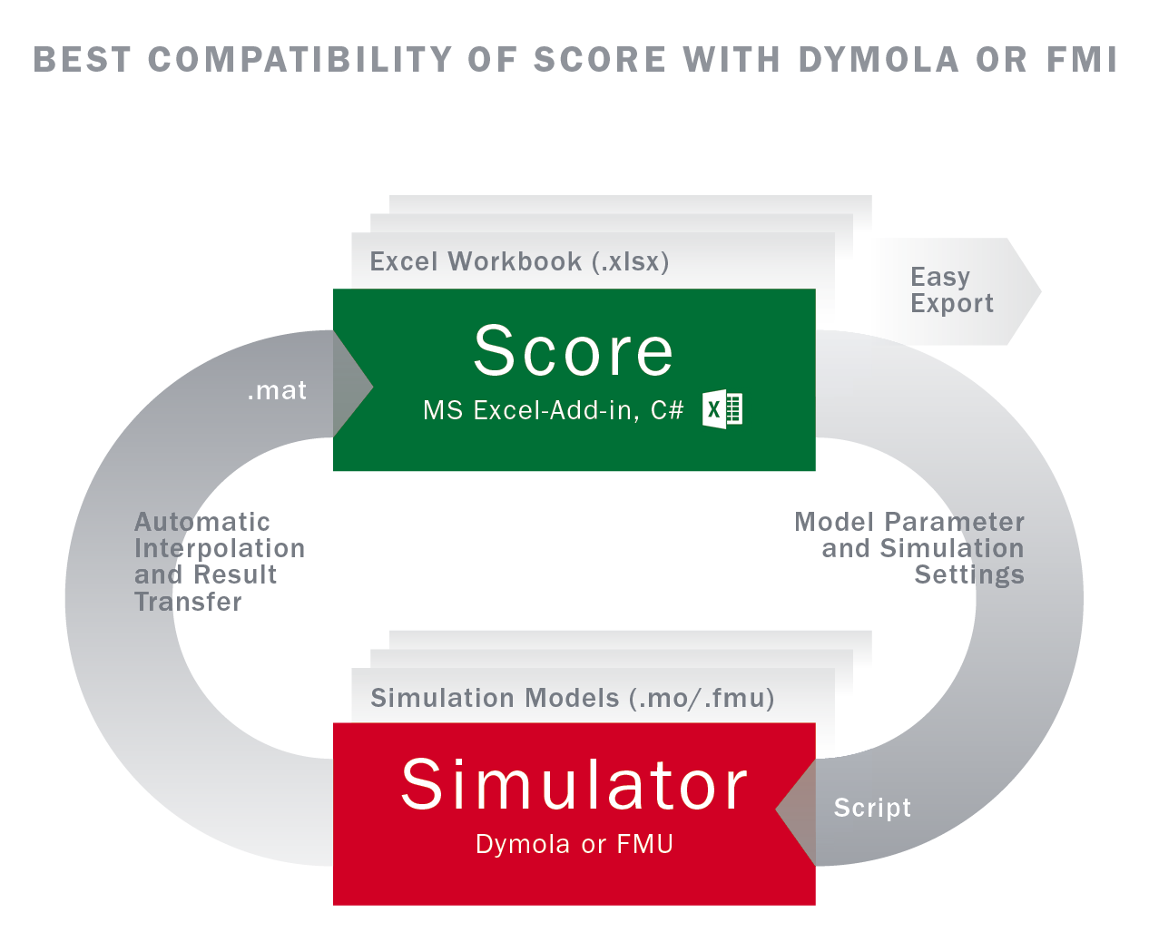
Simulation with Excel
EXCEL-INTERFACE
XRGApplication Score transfers FMU and Dymola results files in Excel files
Score filters and interpolates results
Score transfers parameter tables to Dymola scripts and lets you start Dymola or an FMU directly over an interface to run simulations and import the results.
Easy-Export of Excel workbooks to other users

Slide 16
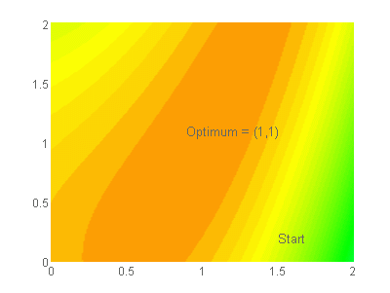
System Optimisation
> The XRGApplication ModelOpt offers a systematic optimization or fitting of Modelica models with regard to any scalar objective function. ModelOpt leads the user through each step and prompts the solution history.
> Any Modelica model depending on float parameters can be optimized by a selection of robust algorithms searching local or global minima.
OPTIMISATION
Normalised Comfort
Normalised Efficiency

Slide 17
CONTACT
For more information, please contact us.
XRG Simulation GmbH
Harburger Schlossstraße 6-12
21079 Hamburg
Germany
+49 40 766 29 26 30
www.xrg-simulation.de/en
info@xrg-simulation.de
We are looking forward to hearing from you.

